Slide 1


Slide 2
Language used to talk about frequency.
Never
Hardly ever
Seldom (almost never)
Every once in a while
Every now and then
Sometimes
Every other day
More often than not
Often
Nearly always
Always

Slide 3
Usage of expressions such as:
As far as
As long as
As much as
As soon as
As often as

Slide 4
Tag questions!
Sound spot act 2
When the intonation goes down you are not really interested in the answer. (1)
When the intonation goes up you are asking a question. (2)

Slide 5
Expressions to draw attention to the cause.
It is essential that
Is of pivotal importance (crucial importance)
Is a paramount (Supreme importance)
Is of utmost importance (extreme importance)
It’s vital that
There is perhaps no better demonstration of
We urge you to

Slide 6


Parallel structures
Not Parallel: Mary likes hiking, swimming, and to ride a bicycle.
Parallel: Mary likes hiking, swimming, and riding a bicycle.

Slide 7
Go chatty
In favour
I’m in.
Count me in.
I’m all for it.
I’m there.
Count on me to…
I’m on board.
Not in favour
I’m out
Forget it.
Don’t count on me.
I’m not doing this.
Not a chance.
Count me out.

Slide 8
Greenwashing

Slide 9
Greenwashing

Slide 10
Greenwashing
It is an strategy used by companies to maker their products appear environmentally
friendly but in reality they aren’t.

Slide 11
Do you know any Brazilian companies which are
greenwashing their products?

Slide 12
How do you fell about them?

Slide 13
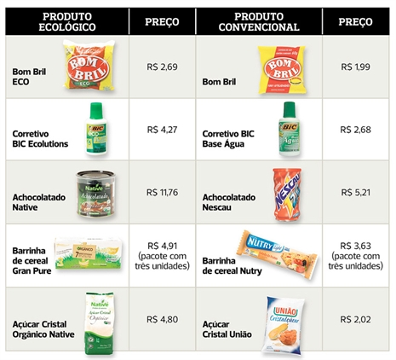

Slide 14
Do you know any Brazilian companies which are
environmentally friendly?

Slide 15
How do you fell about them?

Slide 16
Questions that will help you to improve your talking competence.
What does “blue navy” mean?
How can I say “na verdade isso é um elefante” in English?
How can I pronounce “strategies” correctly?

Slide 17
Unit 2 – Citizens of the world

Slide 18
Citizen of the world

Slide 19
Are you doing something to make the world a better place?

Slide 20
Cosmopolitan

Slide 21
São Paulo the most cosmopolitan city in South America

Slide 22
Cosmopolitan
A place gathering people from many different countries and cultures.
A person familiar with many different countries and cultures.
A cocktail typically made with Vodka, Cointreau, cranberry juice and lime juice

Slide 23
What do you understand by Summarizing?

Slide 24
Note: Those words and expressions were used by Mr. Appiah
for summarizing his extract.

Slide 25
Part A
Basically
Essentially
Part B
In essence
The bottom line is

Slide 26
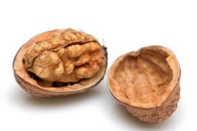
Summarize the extract.
Essentially
Basically
The bottom line is
In short
In a nutshell
In brief
Walnut

Slide 27
What does it mean?
Flyers
NGO

Slide 28

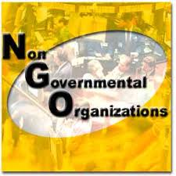
What does it mean?
Flyers
NGO

Slide 29
Make your own flyer and invite people to join you on a noble cause.

Slide 30
Exploring 2
Activity 1

Slide 31
1
3
4
Exploring 2
Activity 1

Slide 32
Exploring 2
Deduction – Your judgement form a direct
observation.
Interference – Your judgement from others’
perspective.
Activity 2

Slide 33
Exploring 2
Activity 2

Slide 34
I tend to think
He must be
He is probably
He can’t be
It seems to me
Exploring 2
Activity 2

Slide 35
Trying out 2 – TALKING TIME
I have been abducted by Aliens

Slide 36
Trying out 2 – TALKING TIME
People keep saying you haven’t been yourself recently.
You have been reading all kinds of publications about ETs and UFOs (unidentified flying object).
You’ve been hearing funny noises at night that no one else hears.
You have developed a strong desire to explore strange new words.
Use the expressions from Exploring 2

